Slide 1
專題研究 week4
吳克駿 江昶翰

Slide 2
Homework
week 1: 02.extract.feat.sh -> Feature Extraction
week 2: 03.mono.train.sh -> Train monophone acoustic model 05.tree.build.sh -> Build decisoin tree 06.tri.train.sh -> Train triphone acoustic mode

Slide 3
Homework
00.train_lm.sh
01.format.sh
04a.01.mono.mkgraph.sh
04a.02.mono.fst.sh
07a.01.tri.mkgraph.sh
07a.02.tri.fst.sh
04b.mono.viterbi.sh
07b.tri.viterbi.sh
or

Slide 4
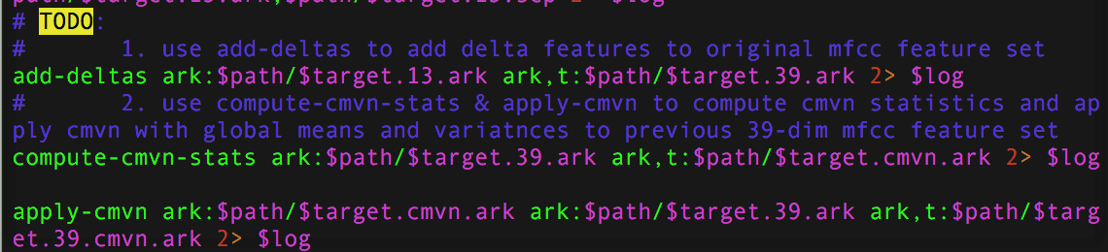
02.extract.feat.sH

Slide 5



02.extract.feat.sh
13-dim MFCC
39-dim MFCC
39-dim CMVN MFCC

Slide 6
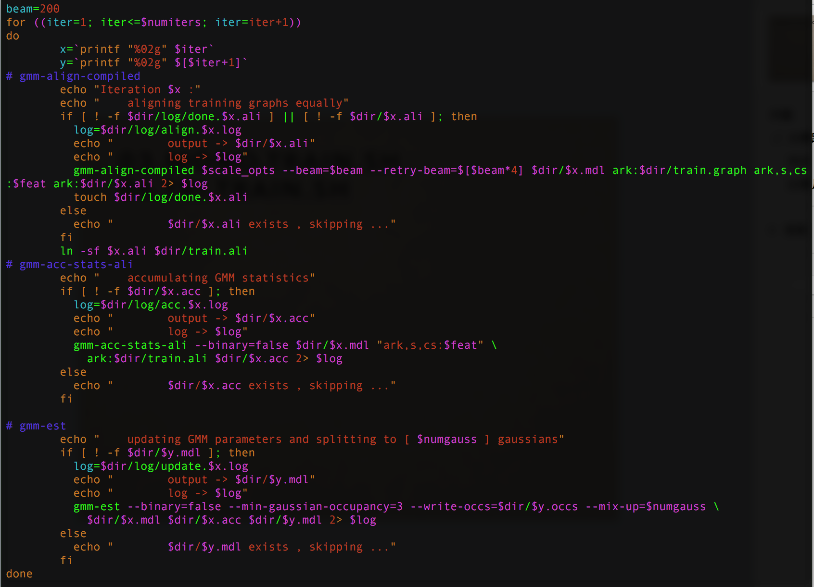
03.mono.train.sh 06.tri.train.sh

Slide 7
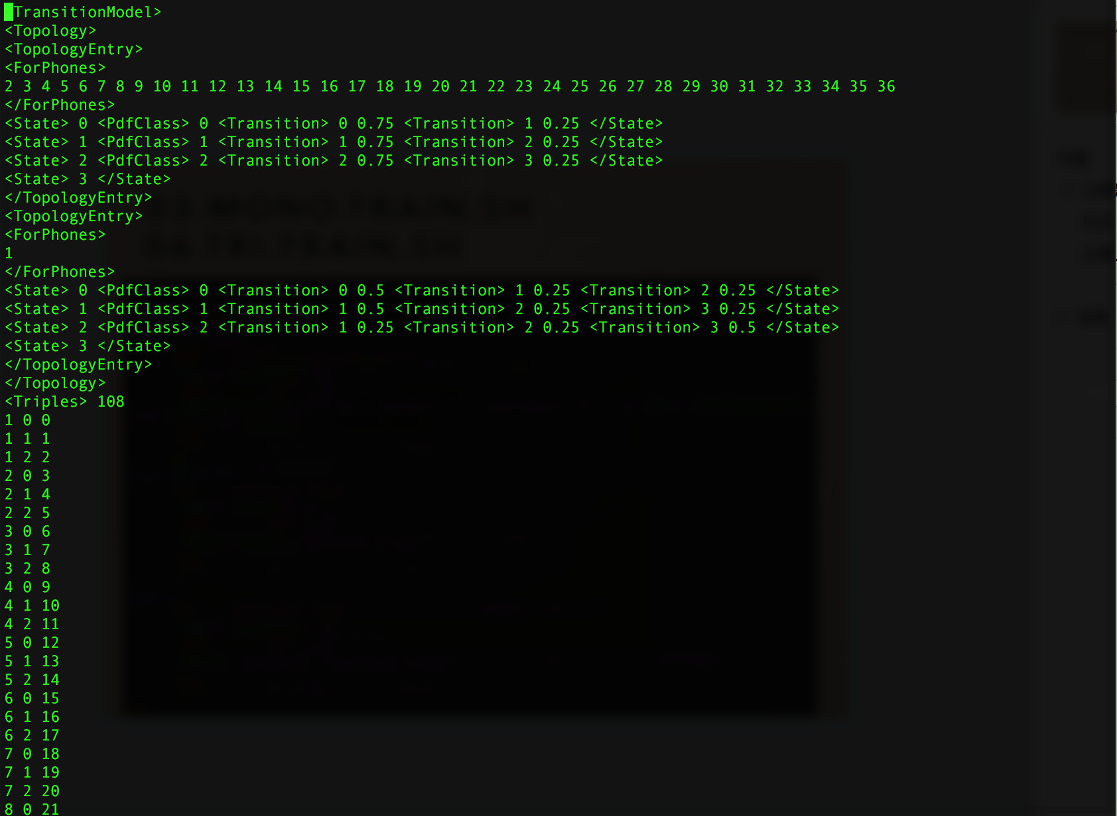
monophone model

Slide 8
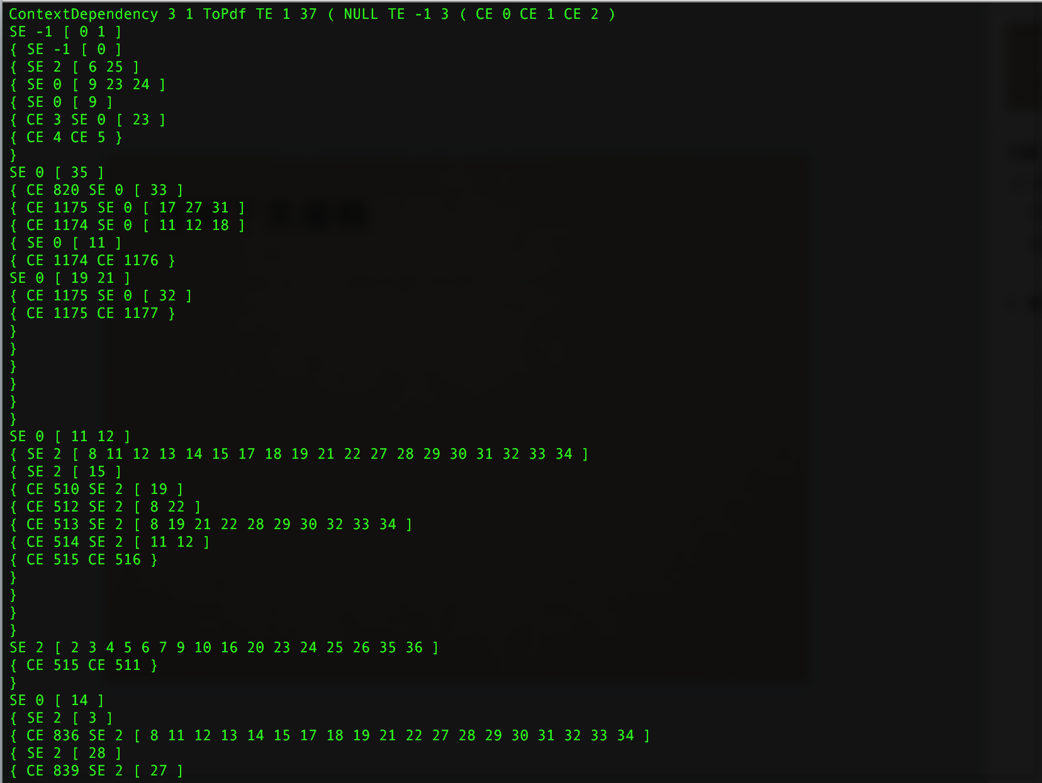
tree

Slide 9
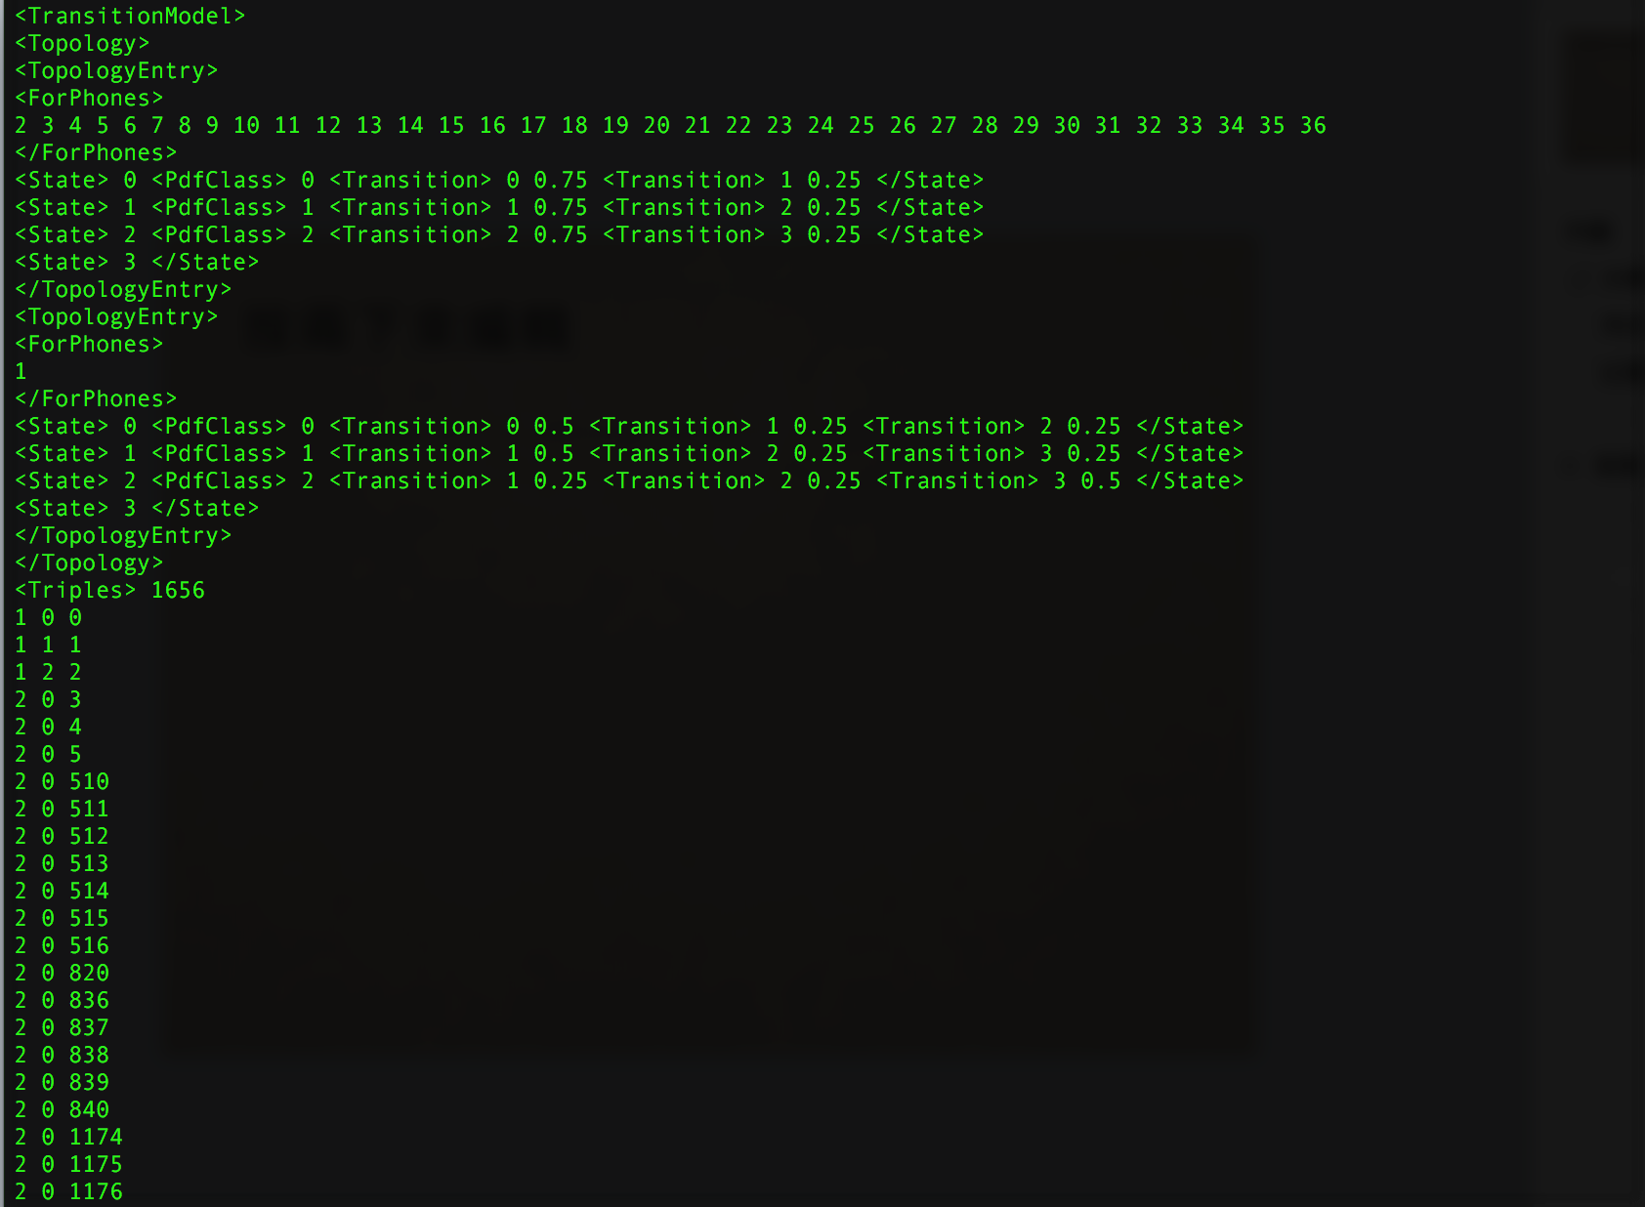
triphone model

Slide 10
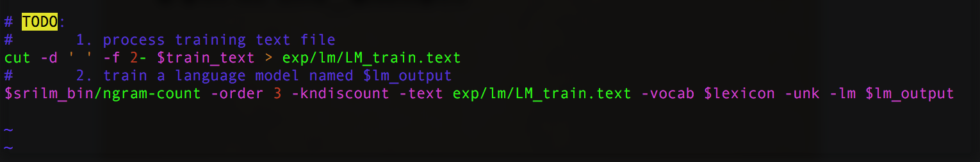
00.train_lm.sh

Slide 11
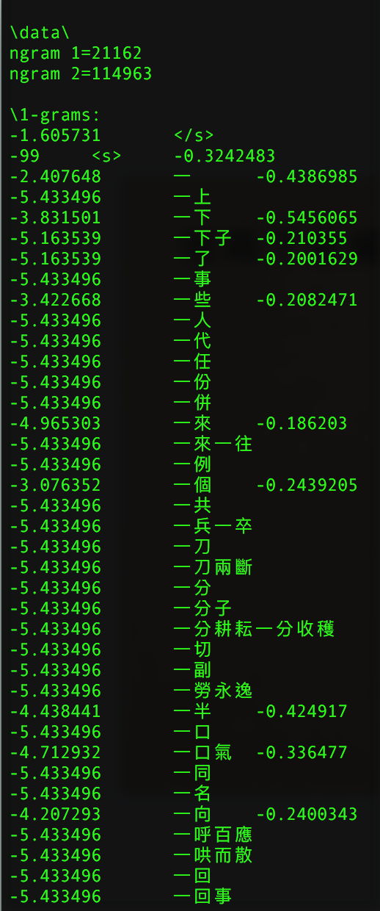
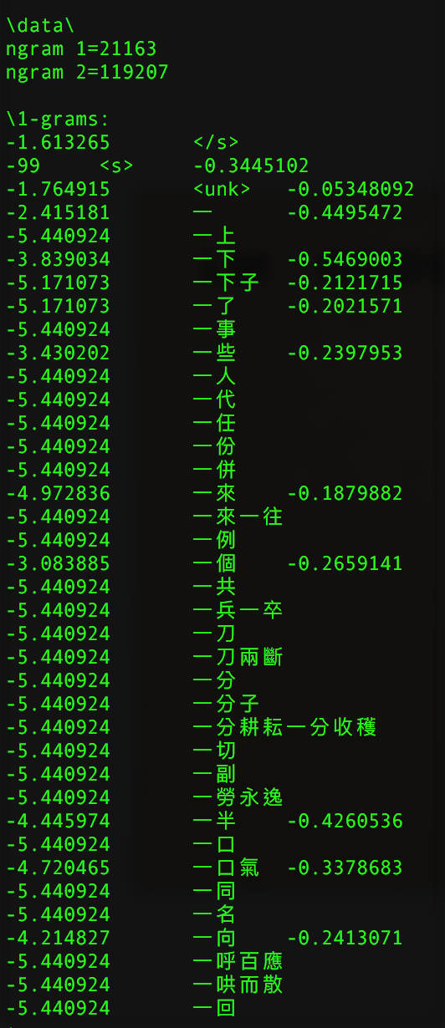
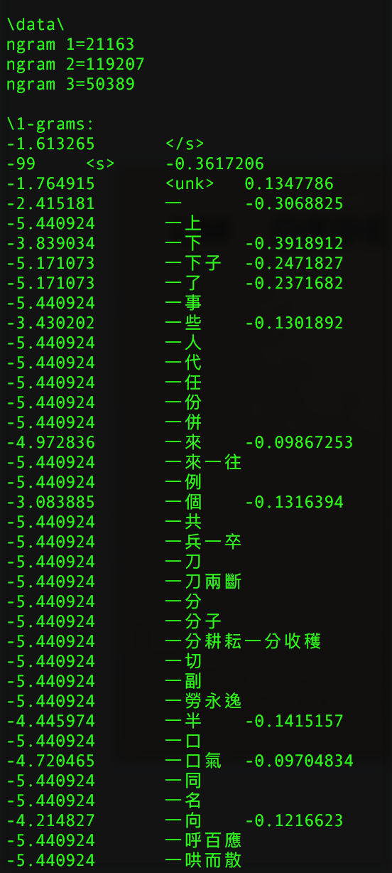
lm
original
order=2
order=3

Slide 12
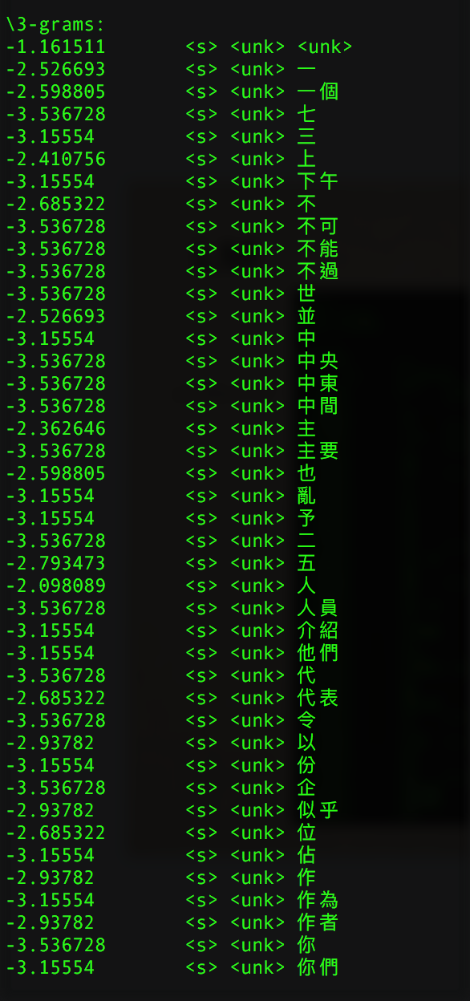

Slide 13
WFST
 | mono WFST | Tri WFST
time | 01:10:39 | 04:07:27
accuracy | 30.49% | 28.21%

Slide 14
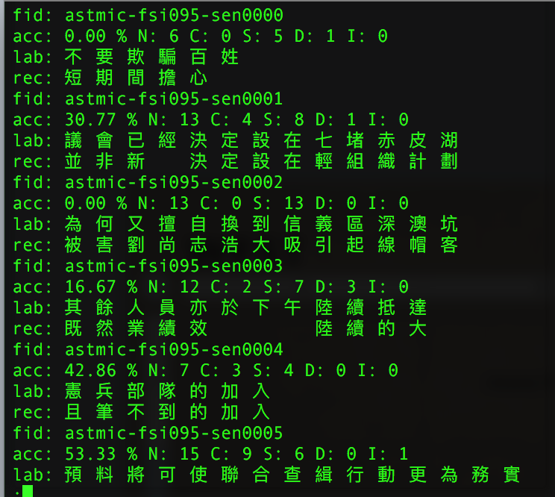
WFST
result: mono

Slide 15
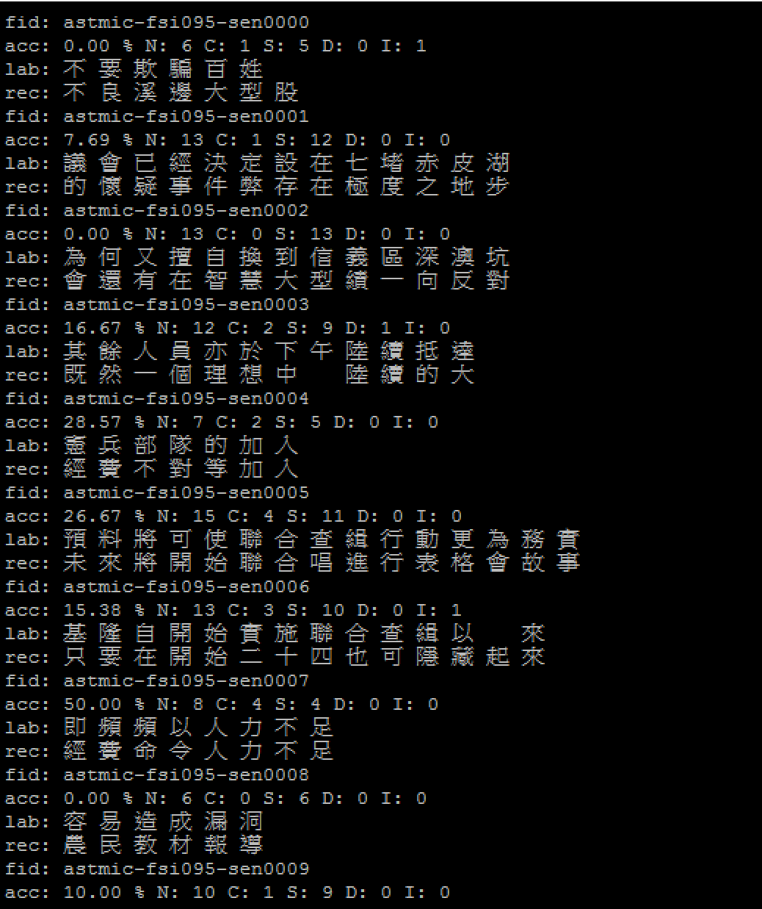
WFST
Result: tri

Slide 16
viterbi
 | mono | tri
time | 00:29:44 | 00:30:38
accuracy | 41.21% | 48.19%

Slide 17
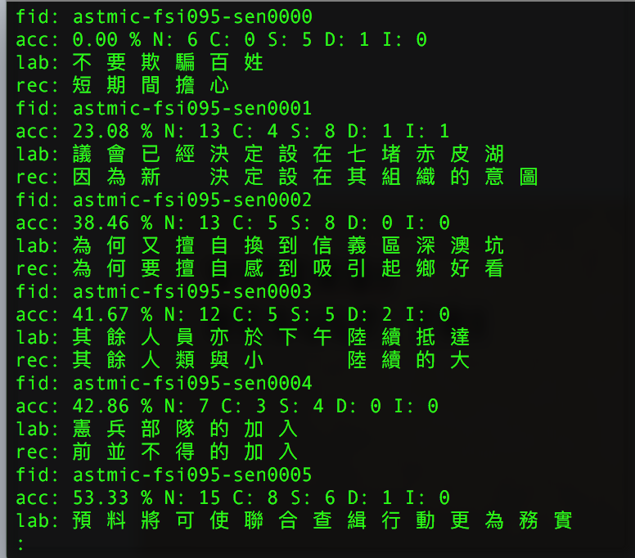
viterbi
result: mono

Slide 18
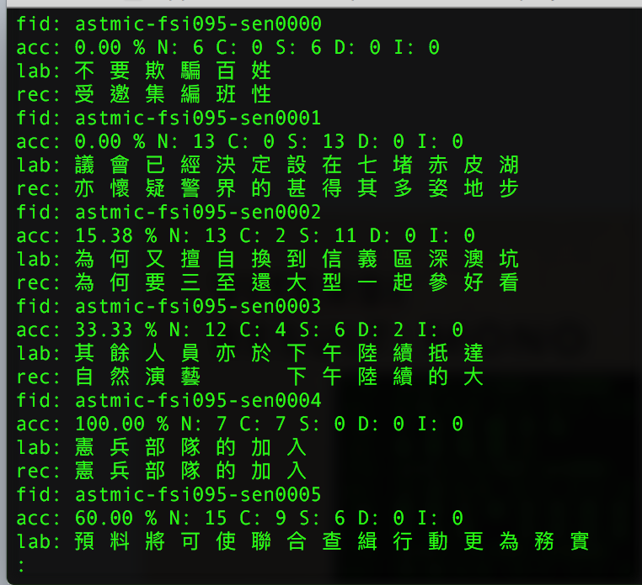
viterbi
Result: tri

Slide 19
compare:
order
order | unigram | bigram | Trigram
mono | 28.19% | 41.21% | 41.98%
TRI | 36.93% | 48.19% | 51.11%

Slide 20
compare:
Gaussian
Gaussian 數量 | 300 | 450 | 600
mono | 41.21% | 42.60% | 42.84%
tri | 48.19% | 49.67% | 49.91%

Slide 21
compare:
am/LM combination
AM佔的比例 | 0.1 | 0.3 | 0.5
mono | 41.21%(0.12) | 41.21%(0.12) | 39.70%(0.10)
tri | 48.19%(0.06) | 48.19%(0.06) | 49.70%(0.10)

Slide 22
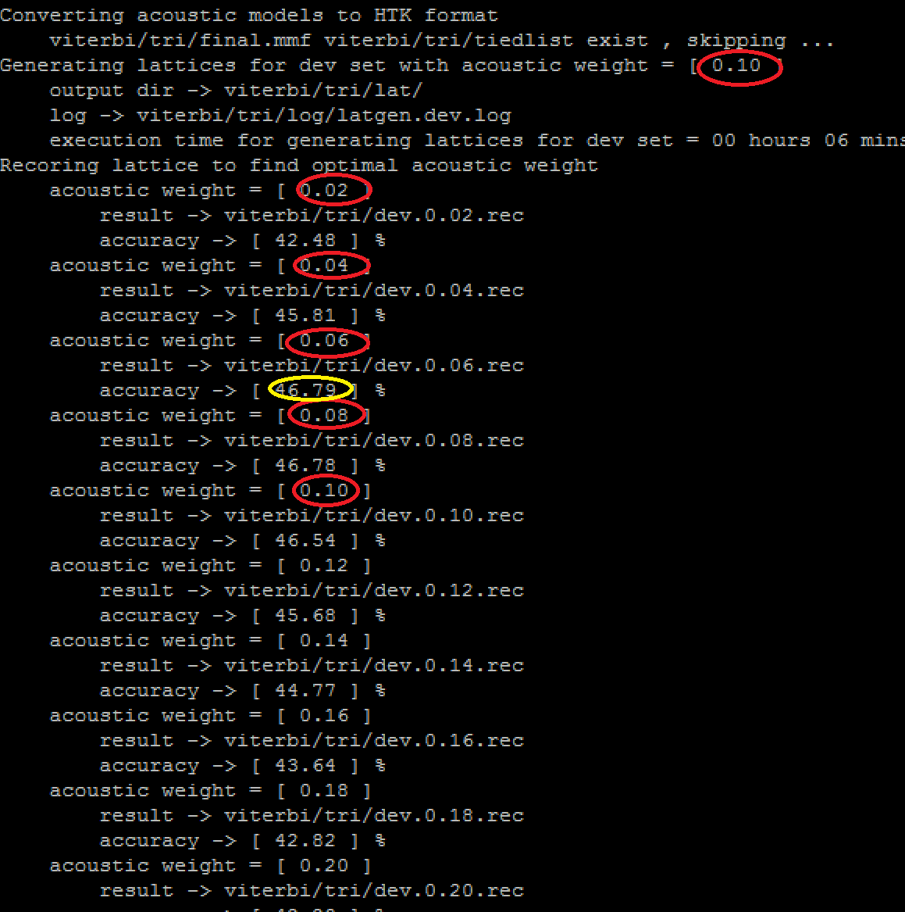
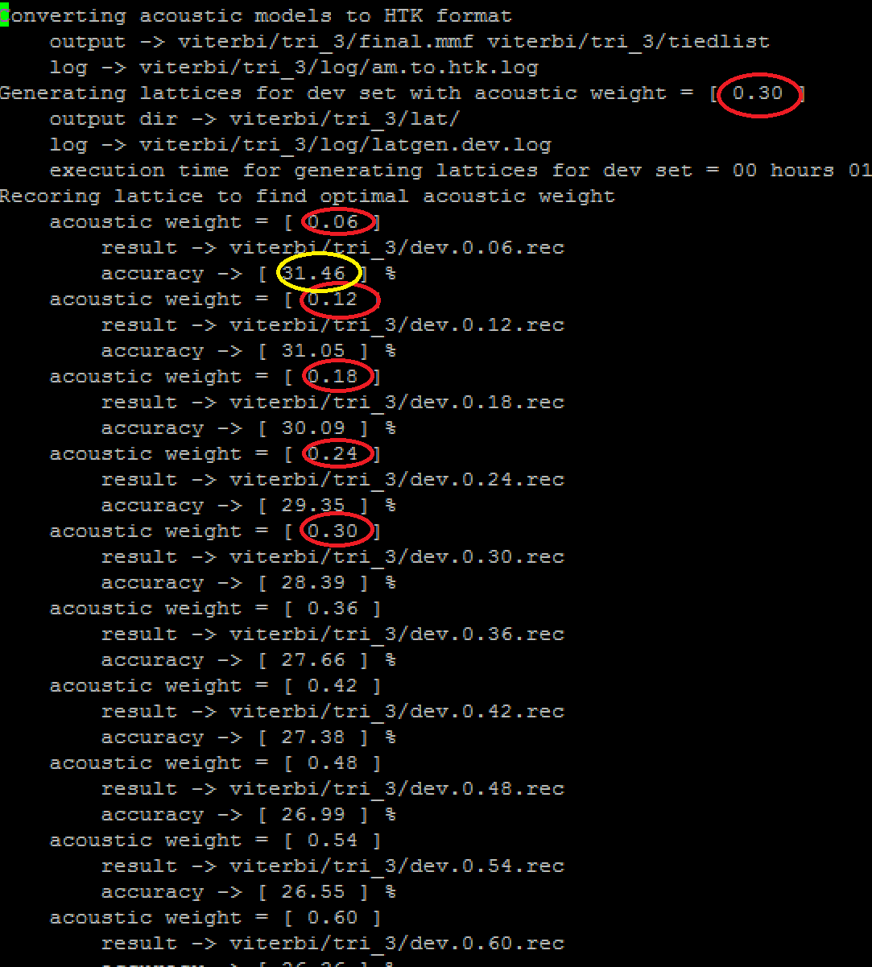
Different AM combitation

Slide 23
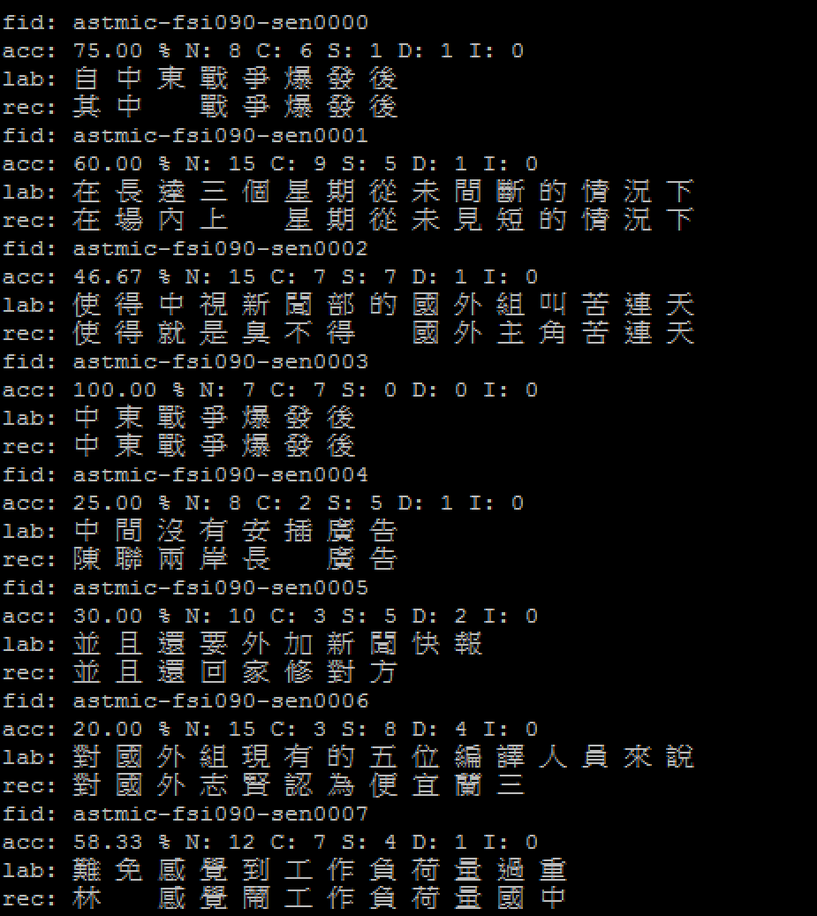
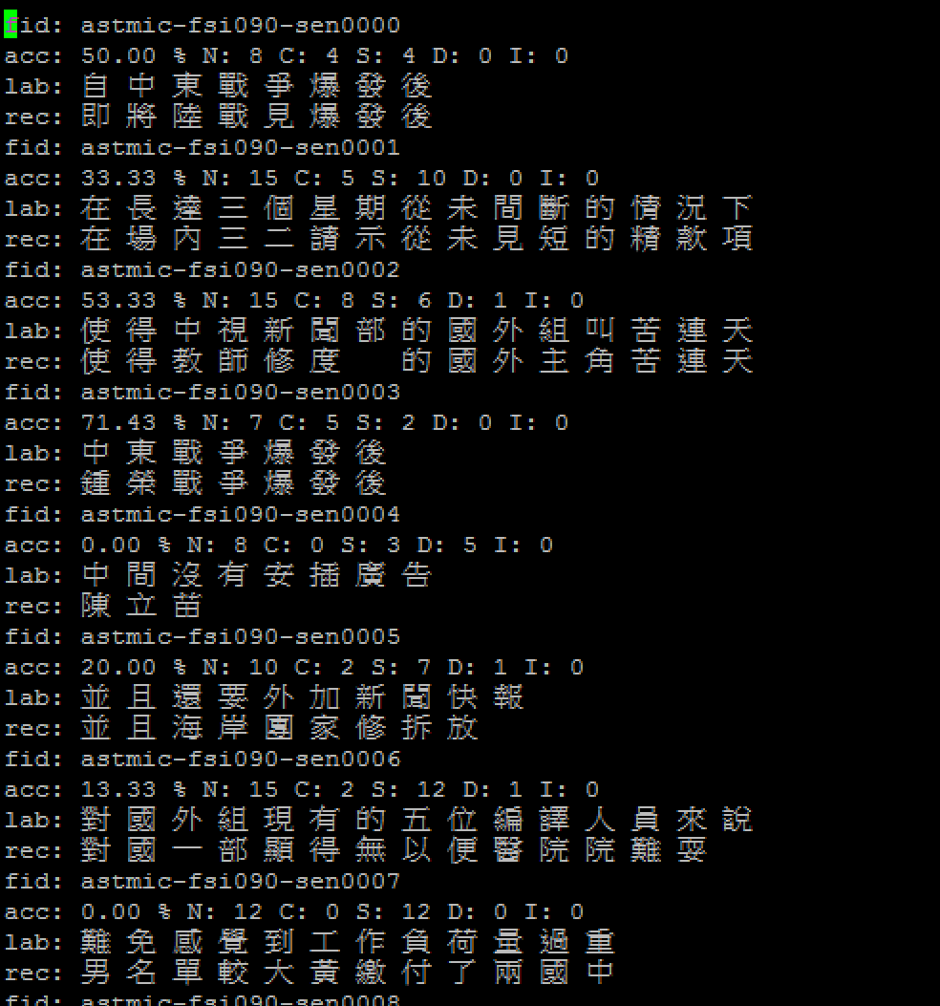
For aM weight 0.06….
DW:0.1
DW:0.3

